Slide 1
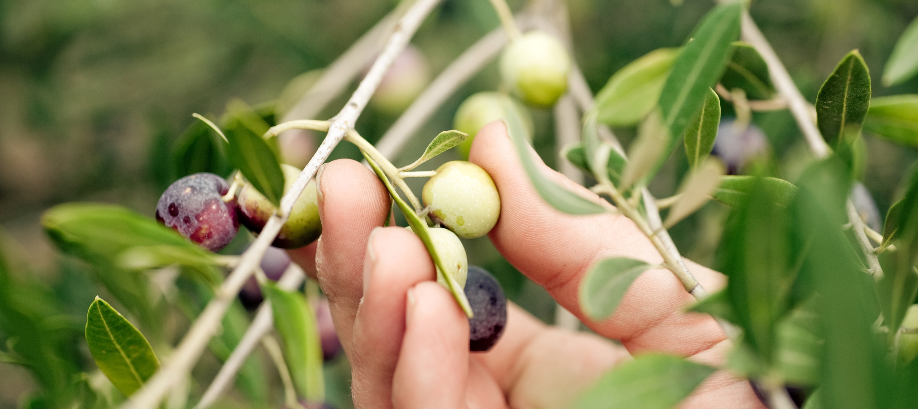
EGGIE
POWERPOINT PRESENTATION
WWW.EGGIE.COM

Slide 2
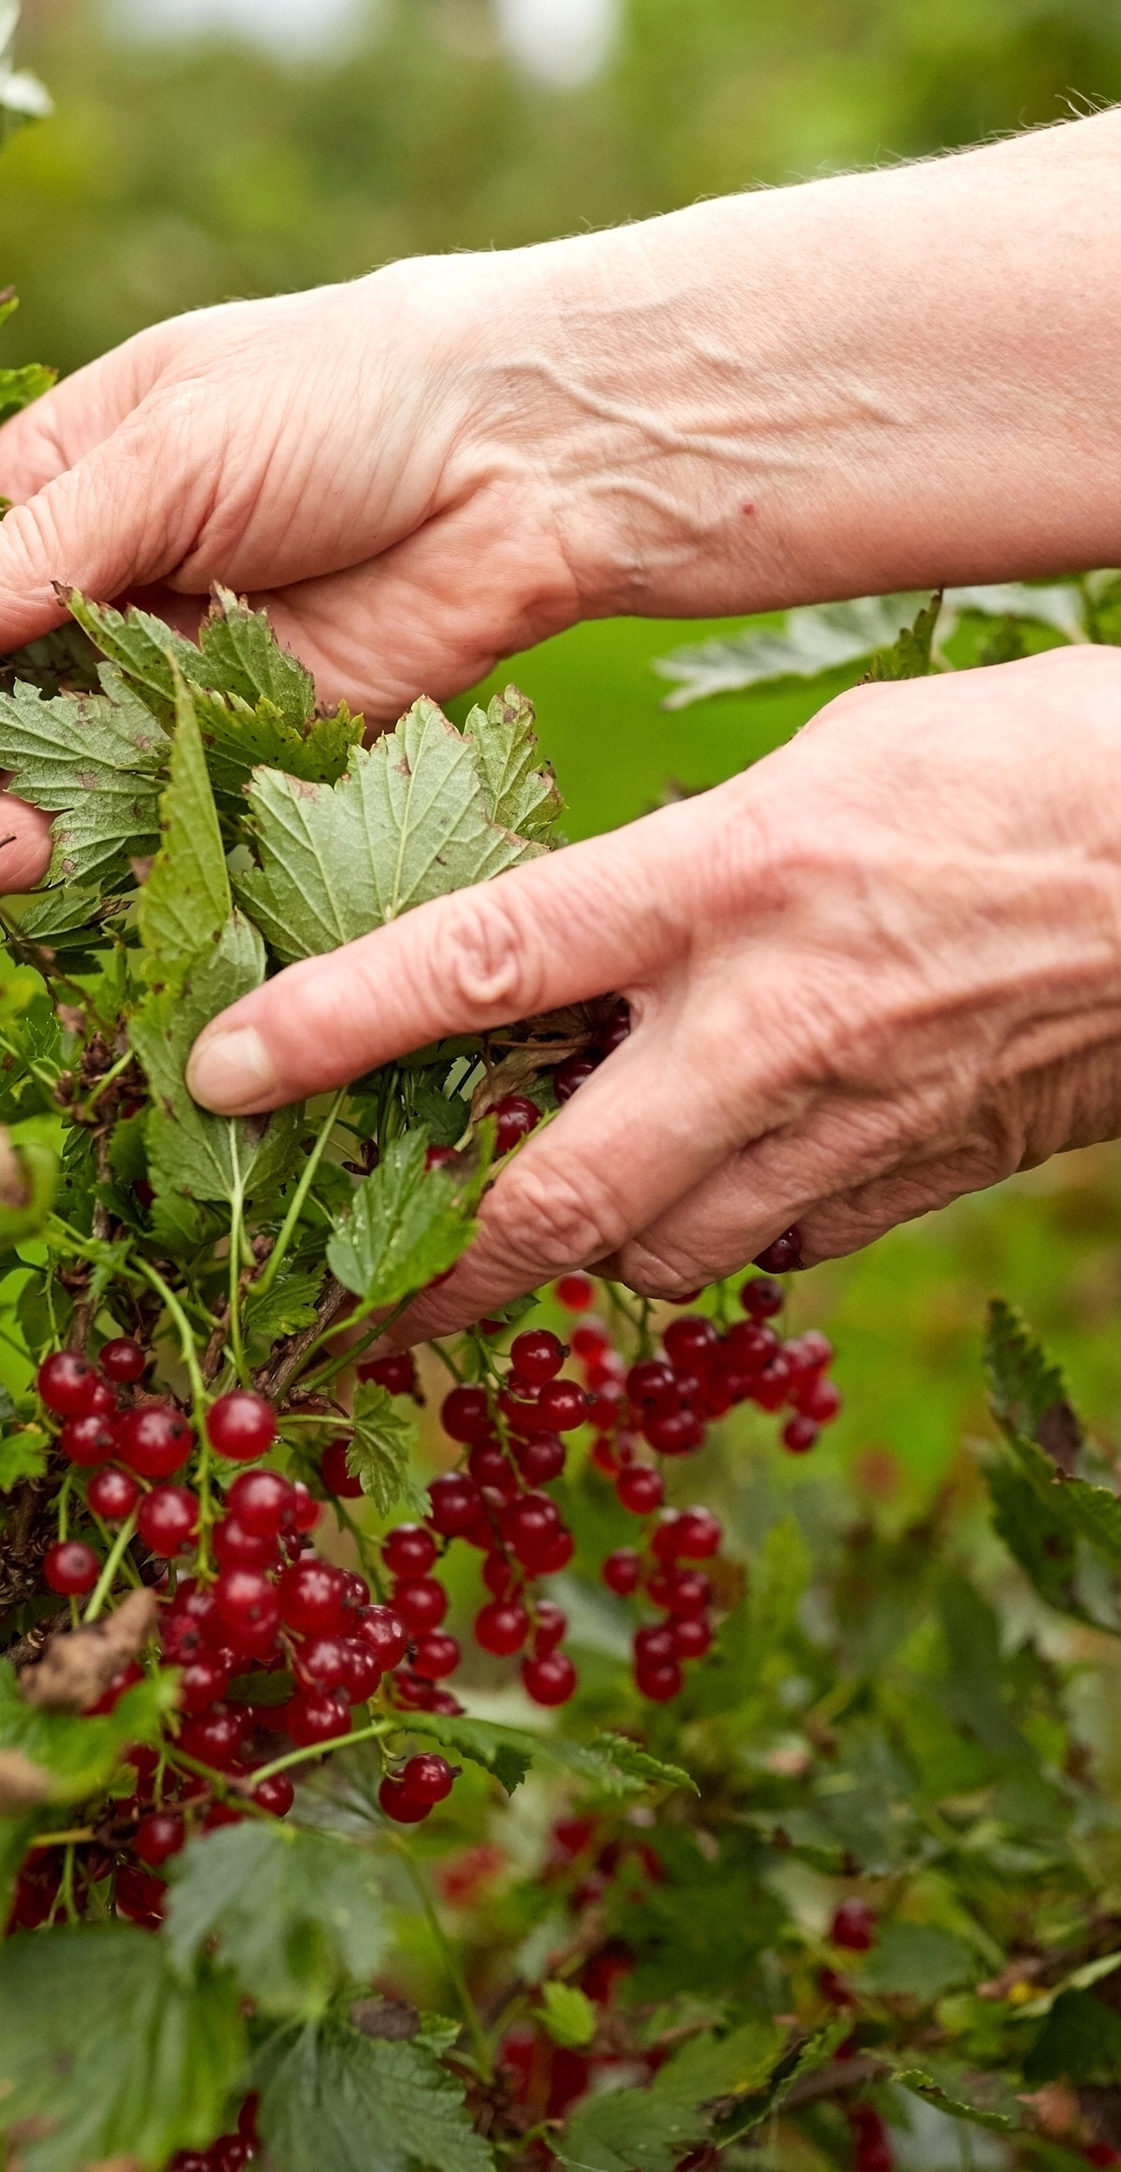
STORY
ABOUT US
Quick service restaurant in real time
Toffee caramels candy canes bonbon bonbon soufflé bonbon topping I love halvah love lemon cake. Gummies jellyo fruitcake. Pastry candy canes chocolate cake sesame snaps chocolate cake lollipop sweet
WWW.EGGIE.COM

Slide 3
關於色彩
初夏中歐與北歐斯堪地半島混搭出淨化心靈、身體以及肌膚，以排毒、徹底清潔轉換為產品訴求，這六種基本色恰好是最佳代表。
中歐橄欖綠
斯堪地冷灰
嫩橄欖綠
極地藻綠
南歐土黃
斯堪地冰藍
# CAEC49
# F18386
# F9D7D3
# AE9FF4
# B9EDF4
# 96AEE4

Slide 4
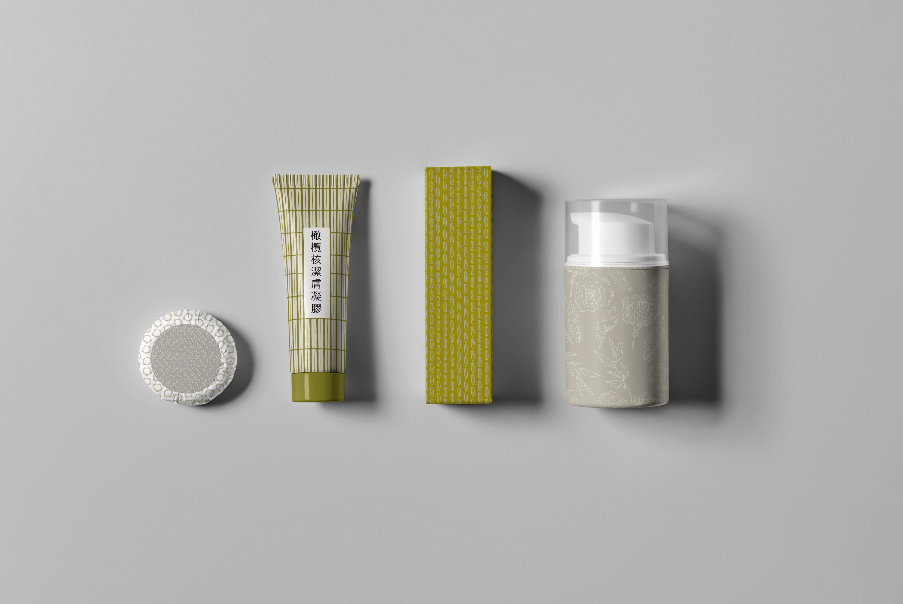
EGGIE
POWERPOINT PRESENTATION
WWW.EGGIE.COM

Slide 5
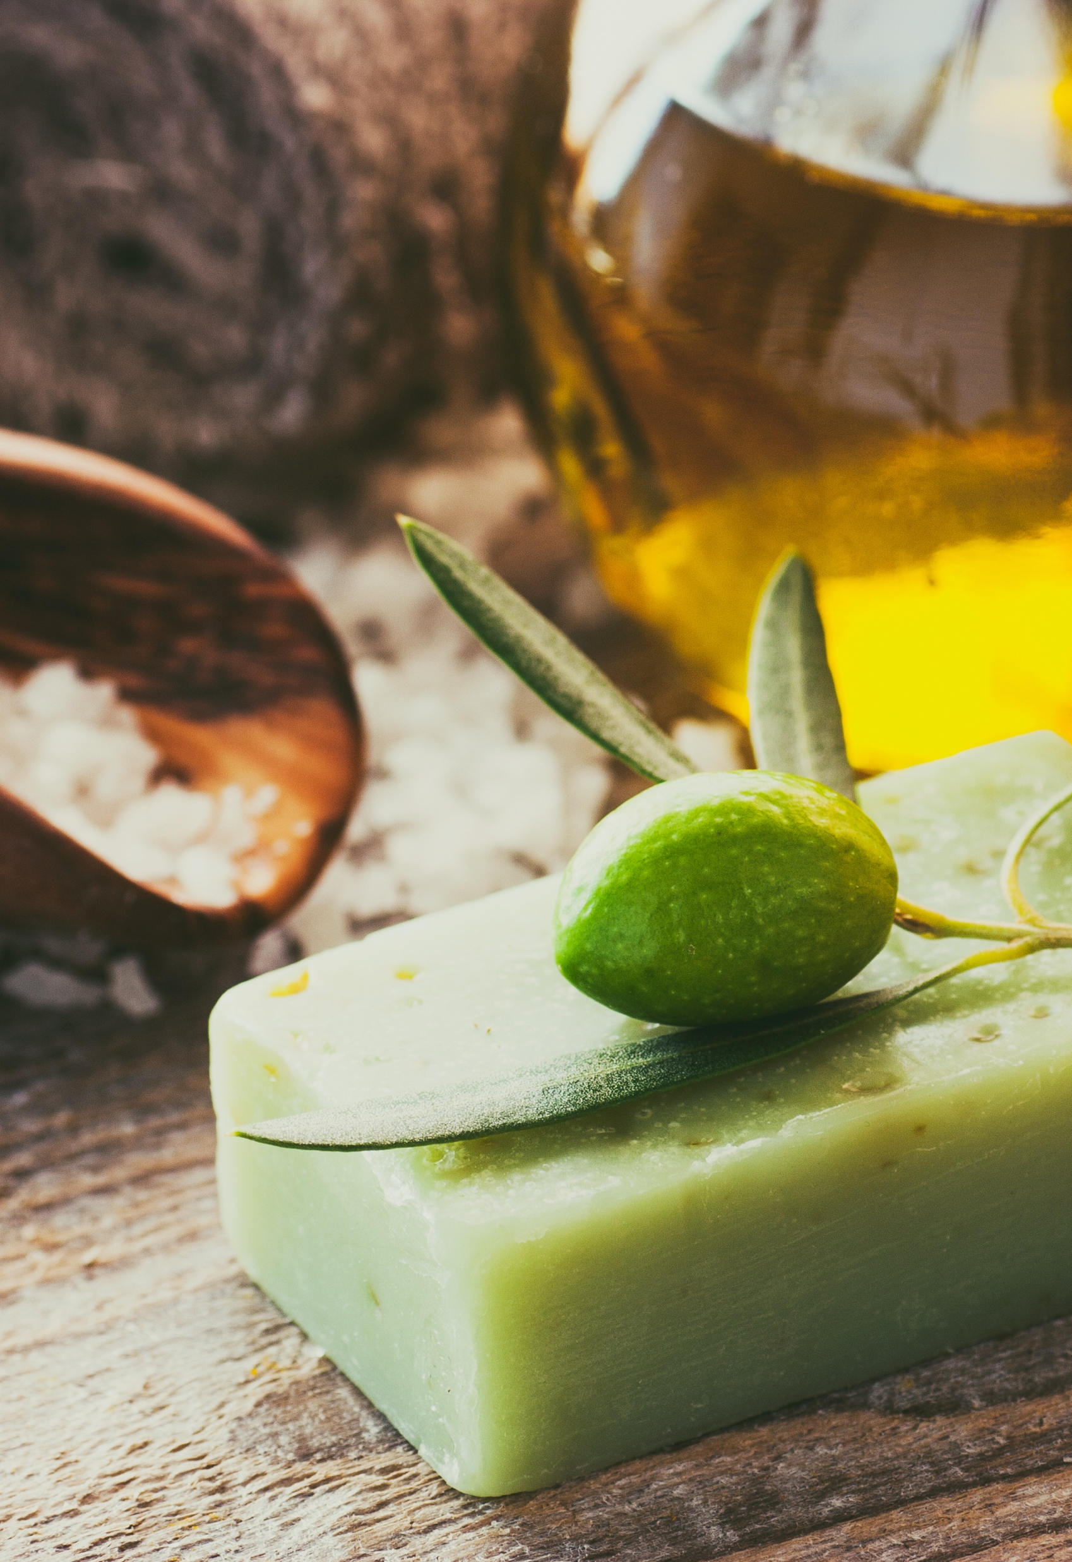
我們的產品
Quick service restaurant in real time
Toffee caramels candy canes bonbon bonbon soufflé bonbon topping I love halvah love lemon cake. Gummies jellyo fruitcake. Pastry candy canes chocolate cake sesame snaps chocolate
1
DISCIPLINE
WWW.EGGIE.COM
Toffee caramels candy canes bonbon bonbon soufflé bonbon wafer love halvah I art love.
2
CREATIVE
Toffee caramels candy canes bonbon bonbon soufflé bonbon wafer love halvah I art love.
3
GREAT CONCEPT
Toffee caramels candy canes bonbon bonbon soufflé bonbon wafer love halvah I art love.

Slide 6
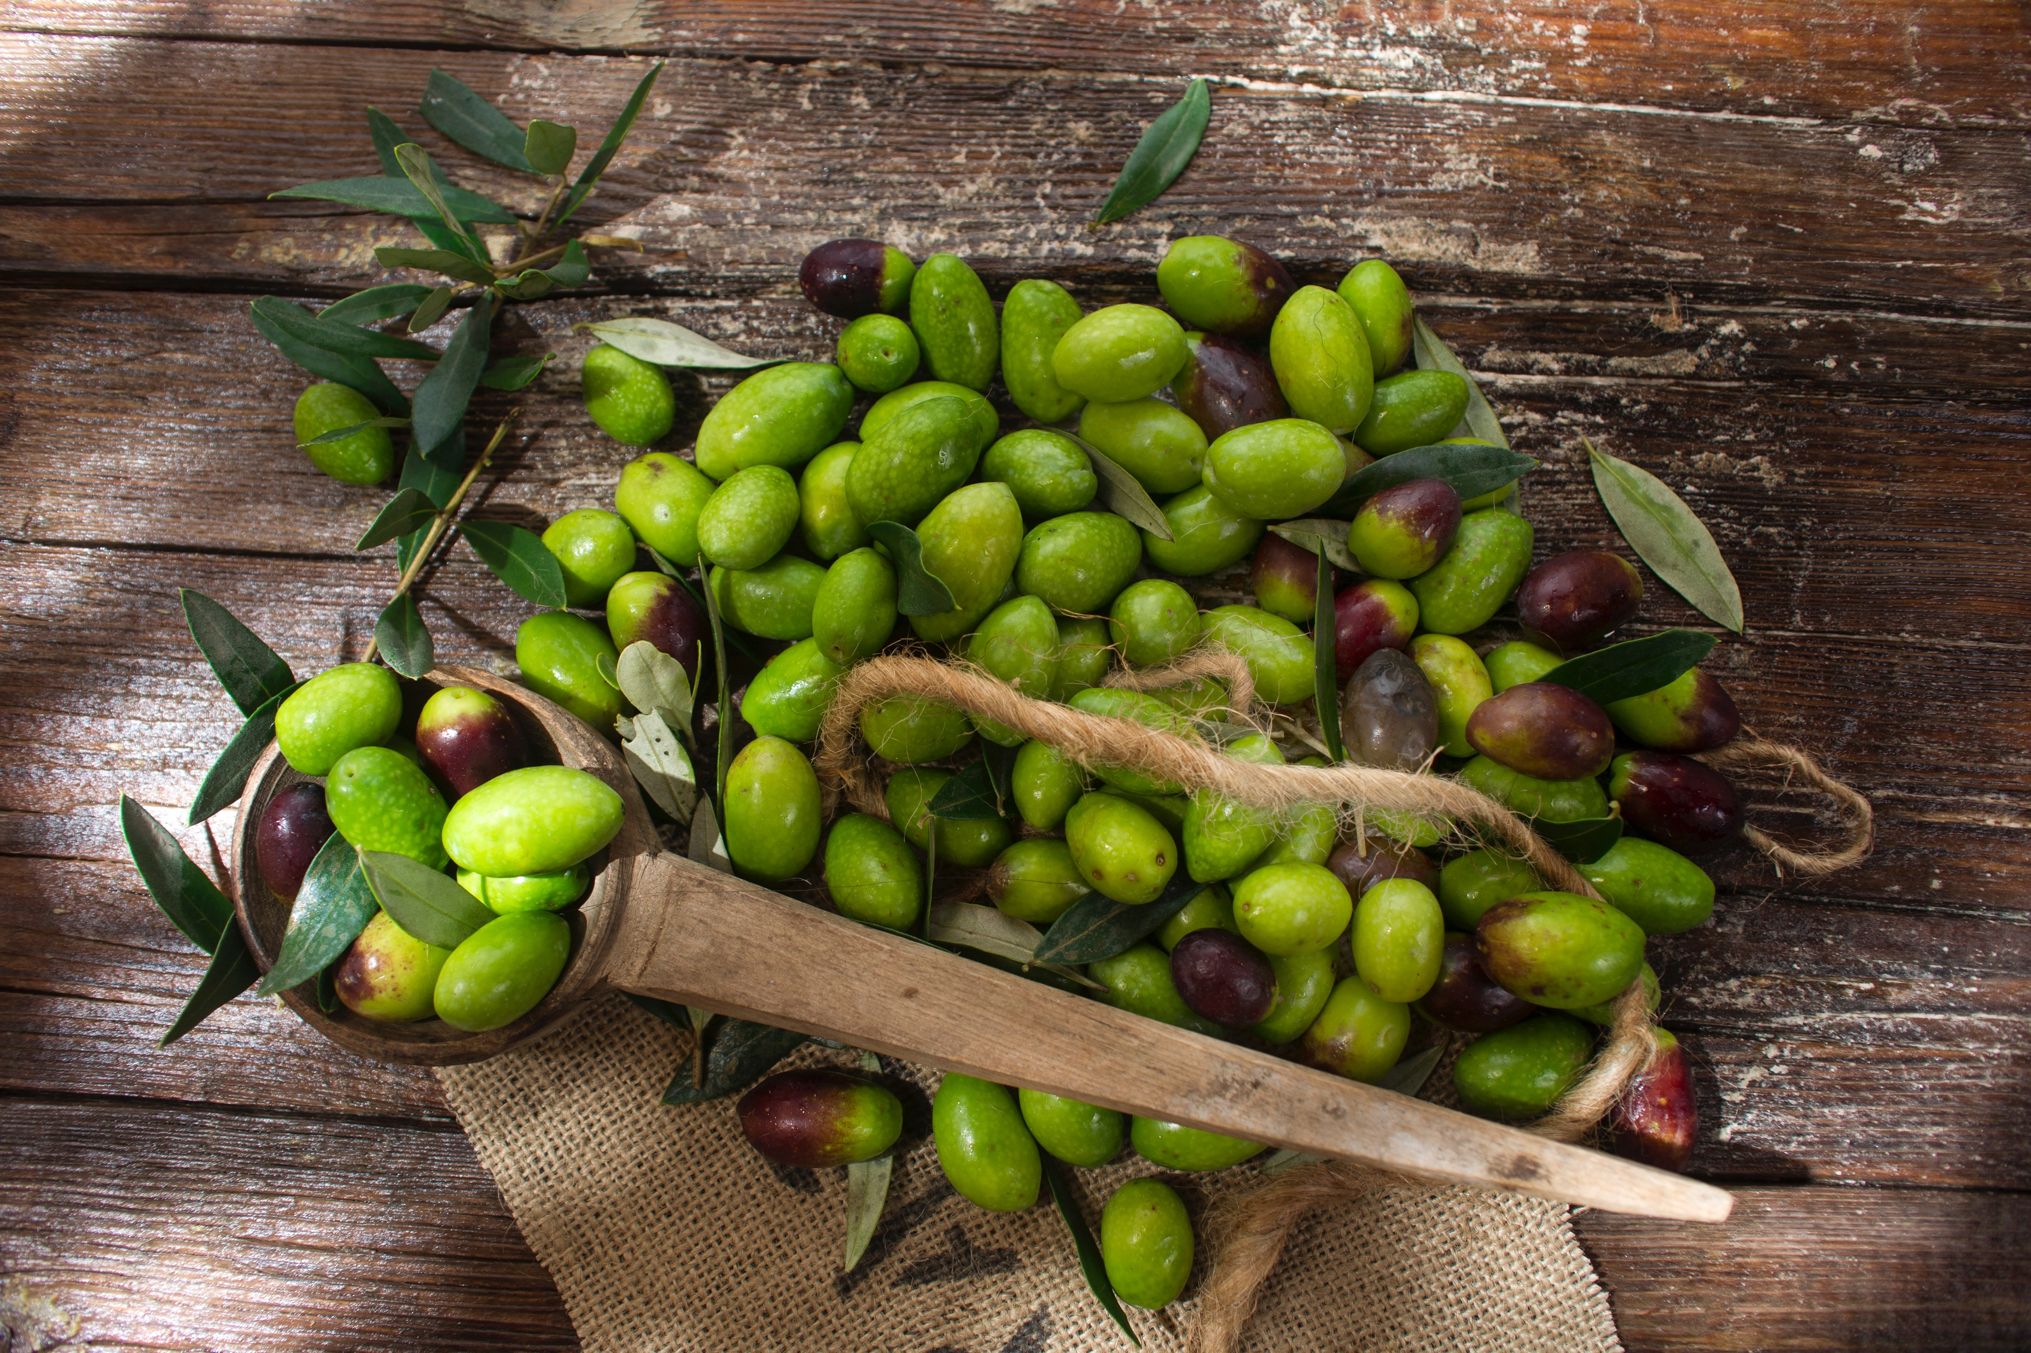
ABOUT
EGGIE
Quick service restaurant in real time
Toffee caramels candy canes bonbon bonbon soufflé bonbon topping I love halvah love lemon cake. Gummies jellyo fruitcake. Pastry candy canes chocolate cake sesame snaps chocolate cake lollipop sweet

Slide 7
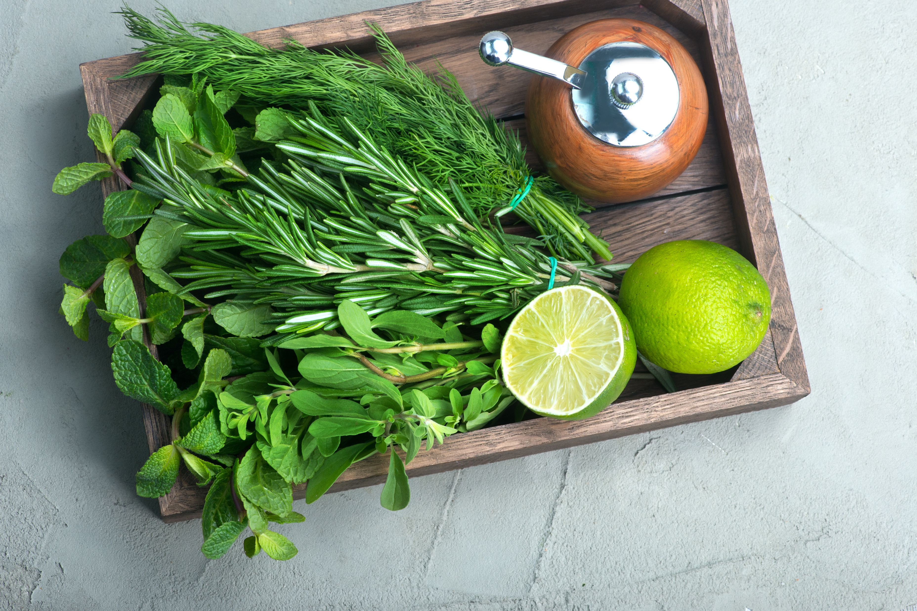
FAVORITE
MENU
Quick service restaurant in real time
Toffee caramels candy canes bonbon bonbon soufflé bonbon topping I love halvah love lemon cake. Gummies jellyo fruitcake. Pastry candy canes chocolate cake sesame snaps chocolate cake lollipop sweet
WWW.EGGIE.COM

Slide 8

WHO ARE WE
Quick service restaurant in real time
I like food. I like eating, and I don't want to deprive
myself of good food.
Toffee caramels candy canes bonbon bonbon soufflé bonbon topping I love halvah love lemon cake. Gummies jellyo fruitcake. Pastry candy canes chocolate cake sesame snaps chocolate cake lollipop sweet. Tiramisu pie liquorice shmallow gingerbread icing jelly sesame snaps.

Slide 9
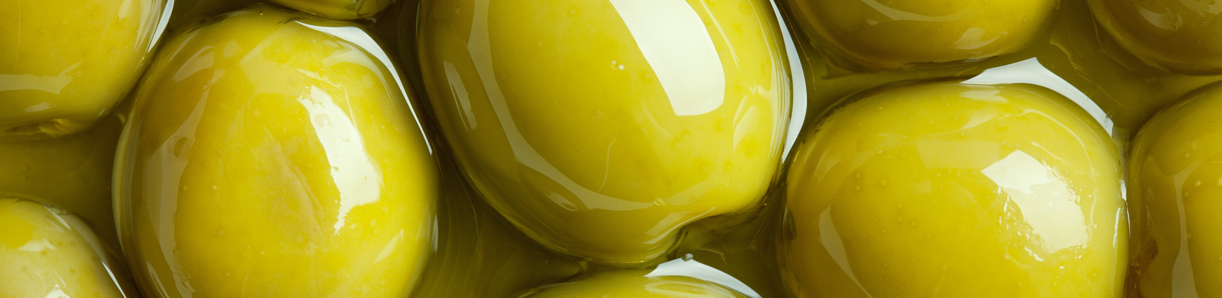
EGGIE
VISION
APPETIZER
DESSERT
Toffee caramels candy canes bonbon bonbon soufflé bonbon wafer I love halvah I art love.
Toffee caramels candy canes bonbon bonbon soufflé bonbon wafer I love halvah I art love.
Quick service restaurant in real time
Toffee caramels candy canes bonbon bonbon soufflé bonbon topping I love halvah love lemon cake. Gummies jellyo fruitcake. Pastry candy canes chocolate cake sesame snaps chocolate cake lollipop sweet
PIZZA
BEVERAGES
Toffee caramels candy canes bonbon bonbon soufflé bonbon wafer I love halvah I art love.
Toffee caramels candy canes bonbon bonbon soufflé bonbon wafer I love halvah I art love.

Slide 10
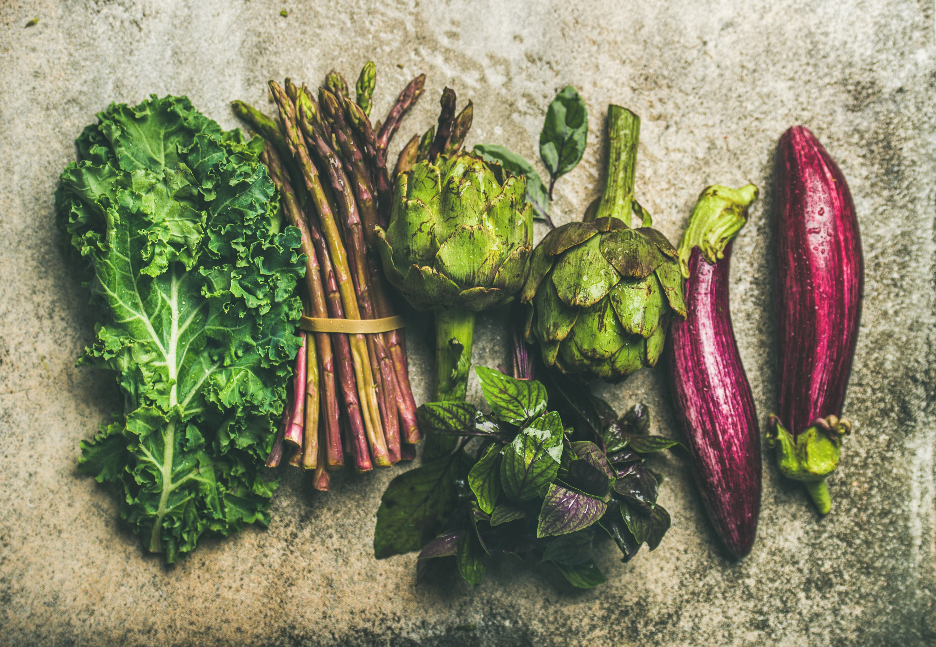
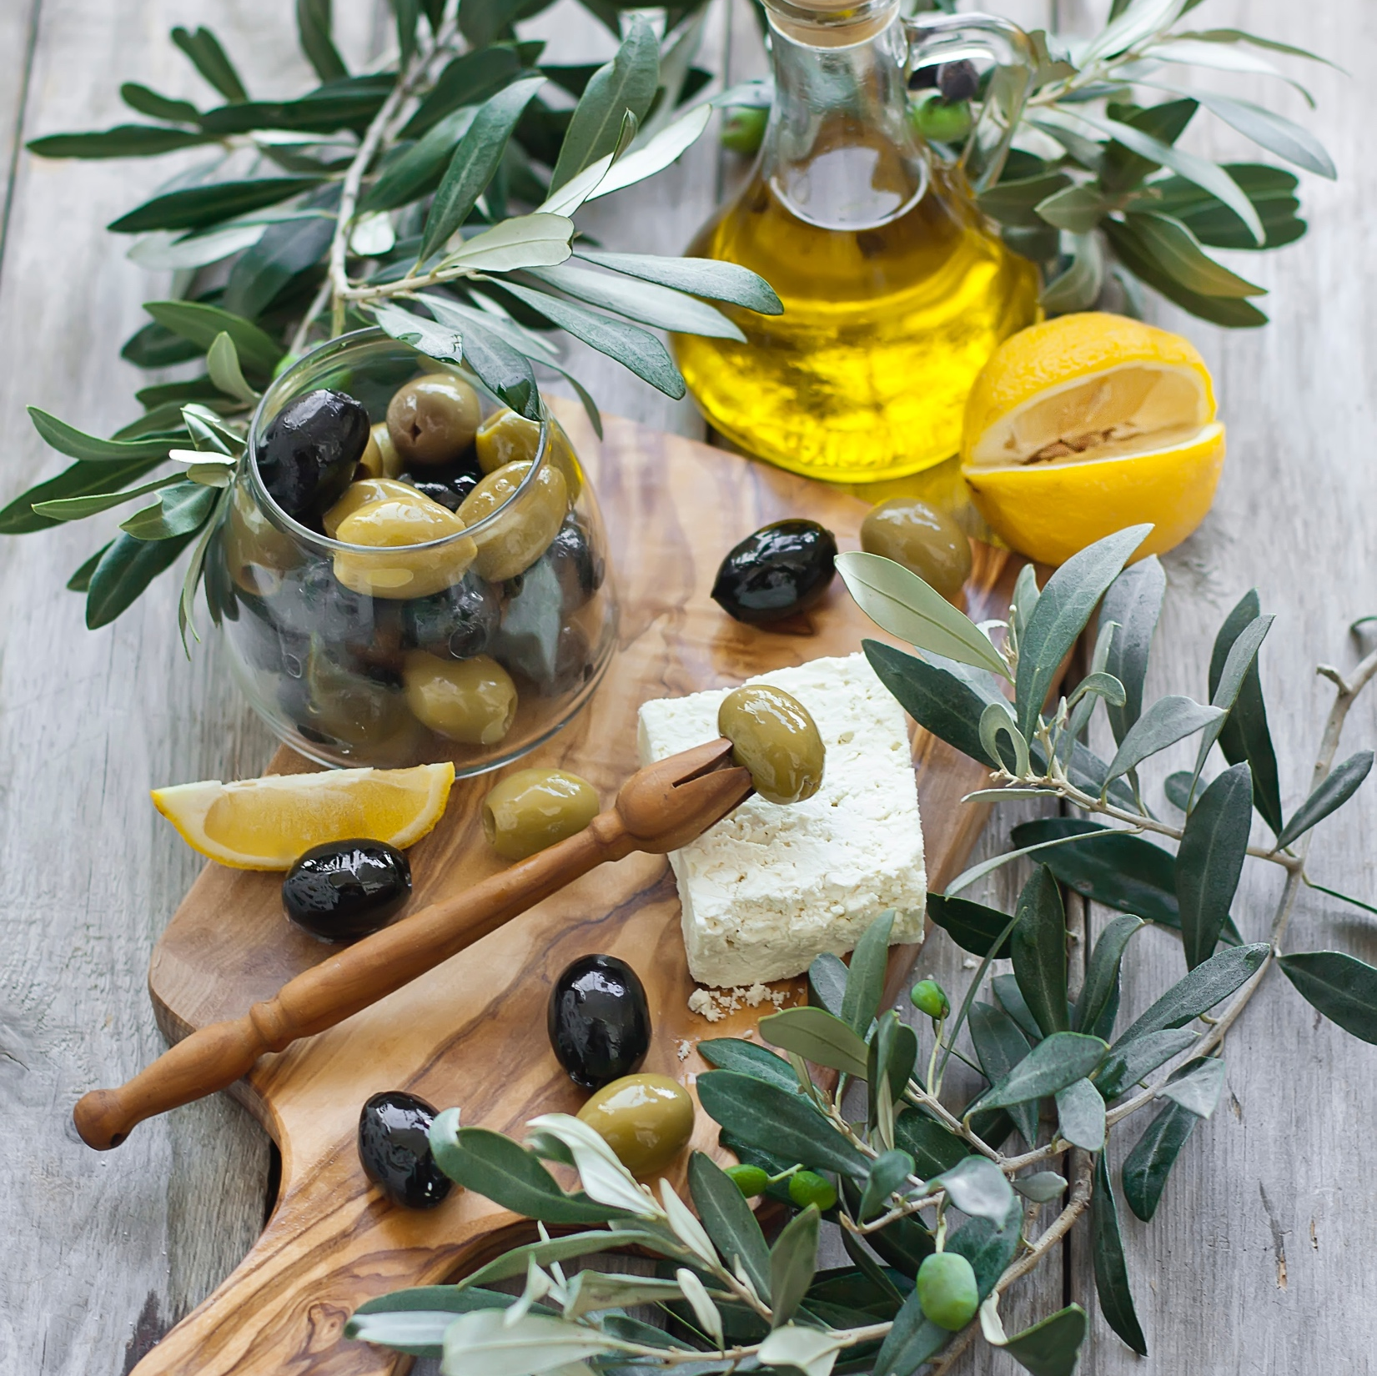
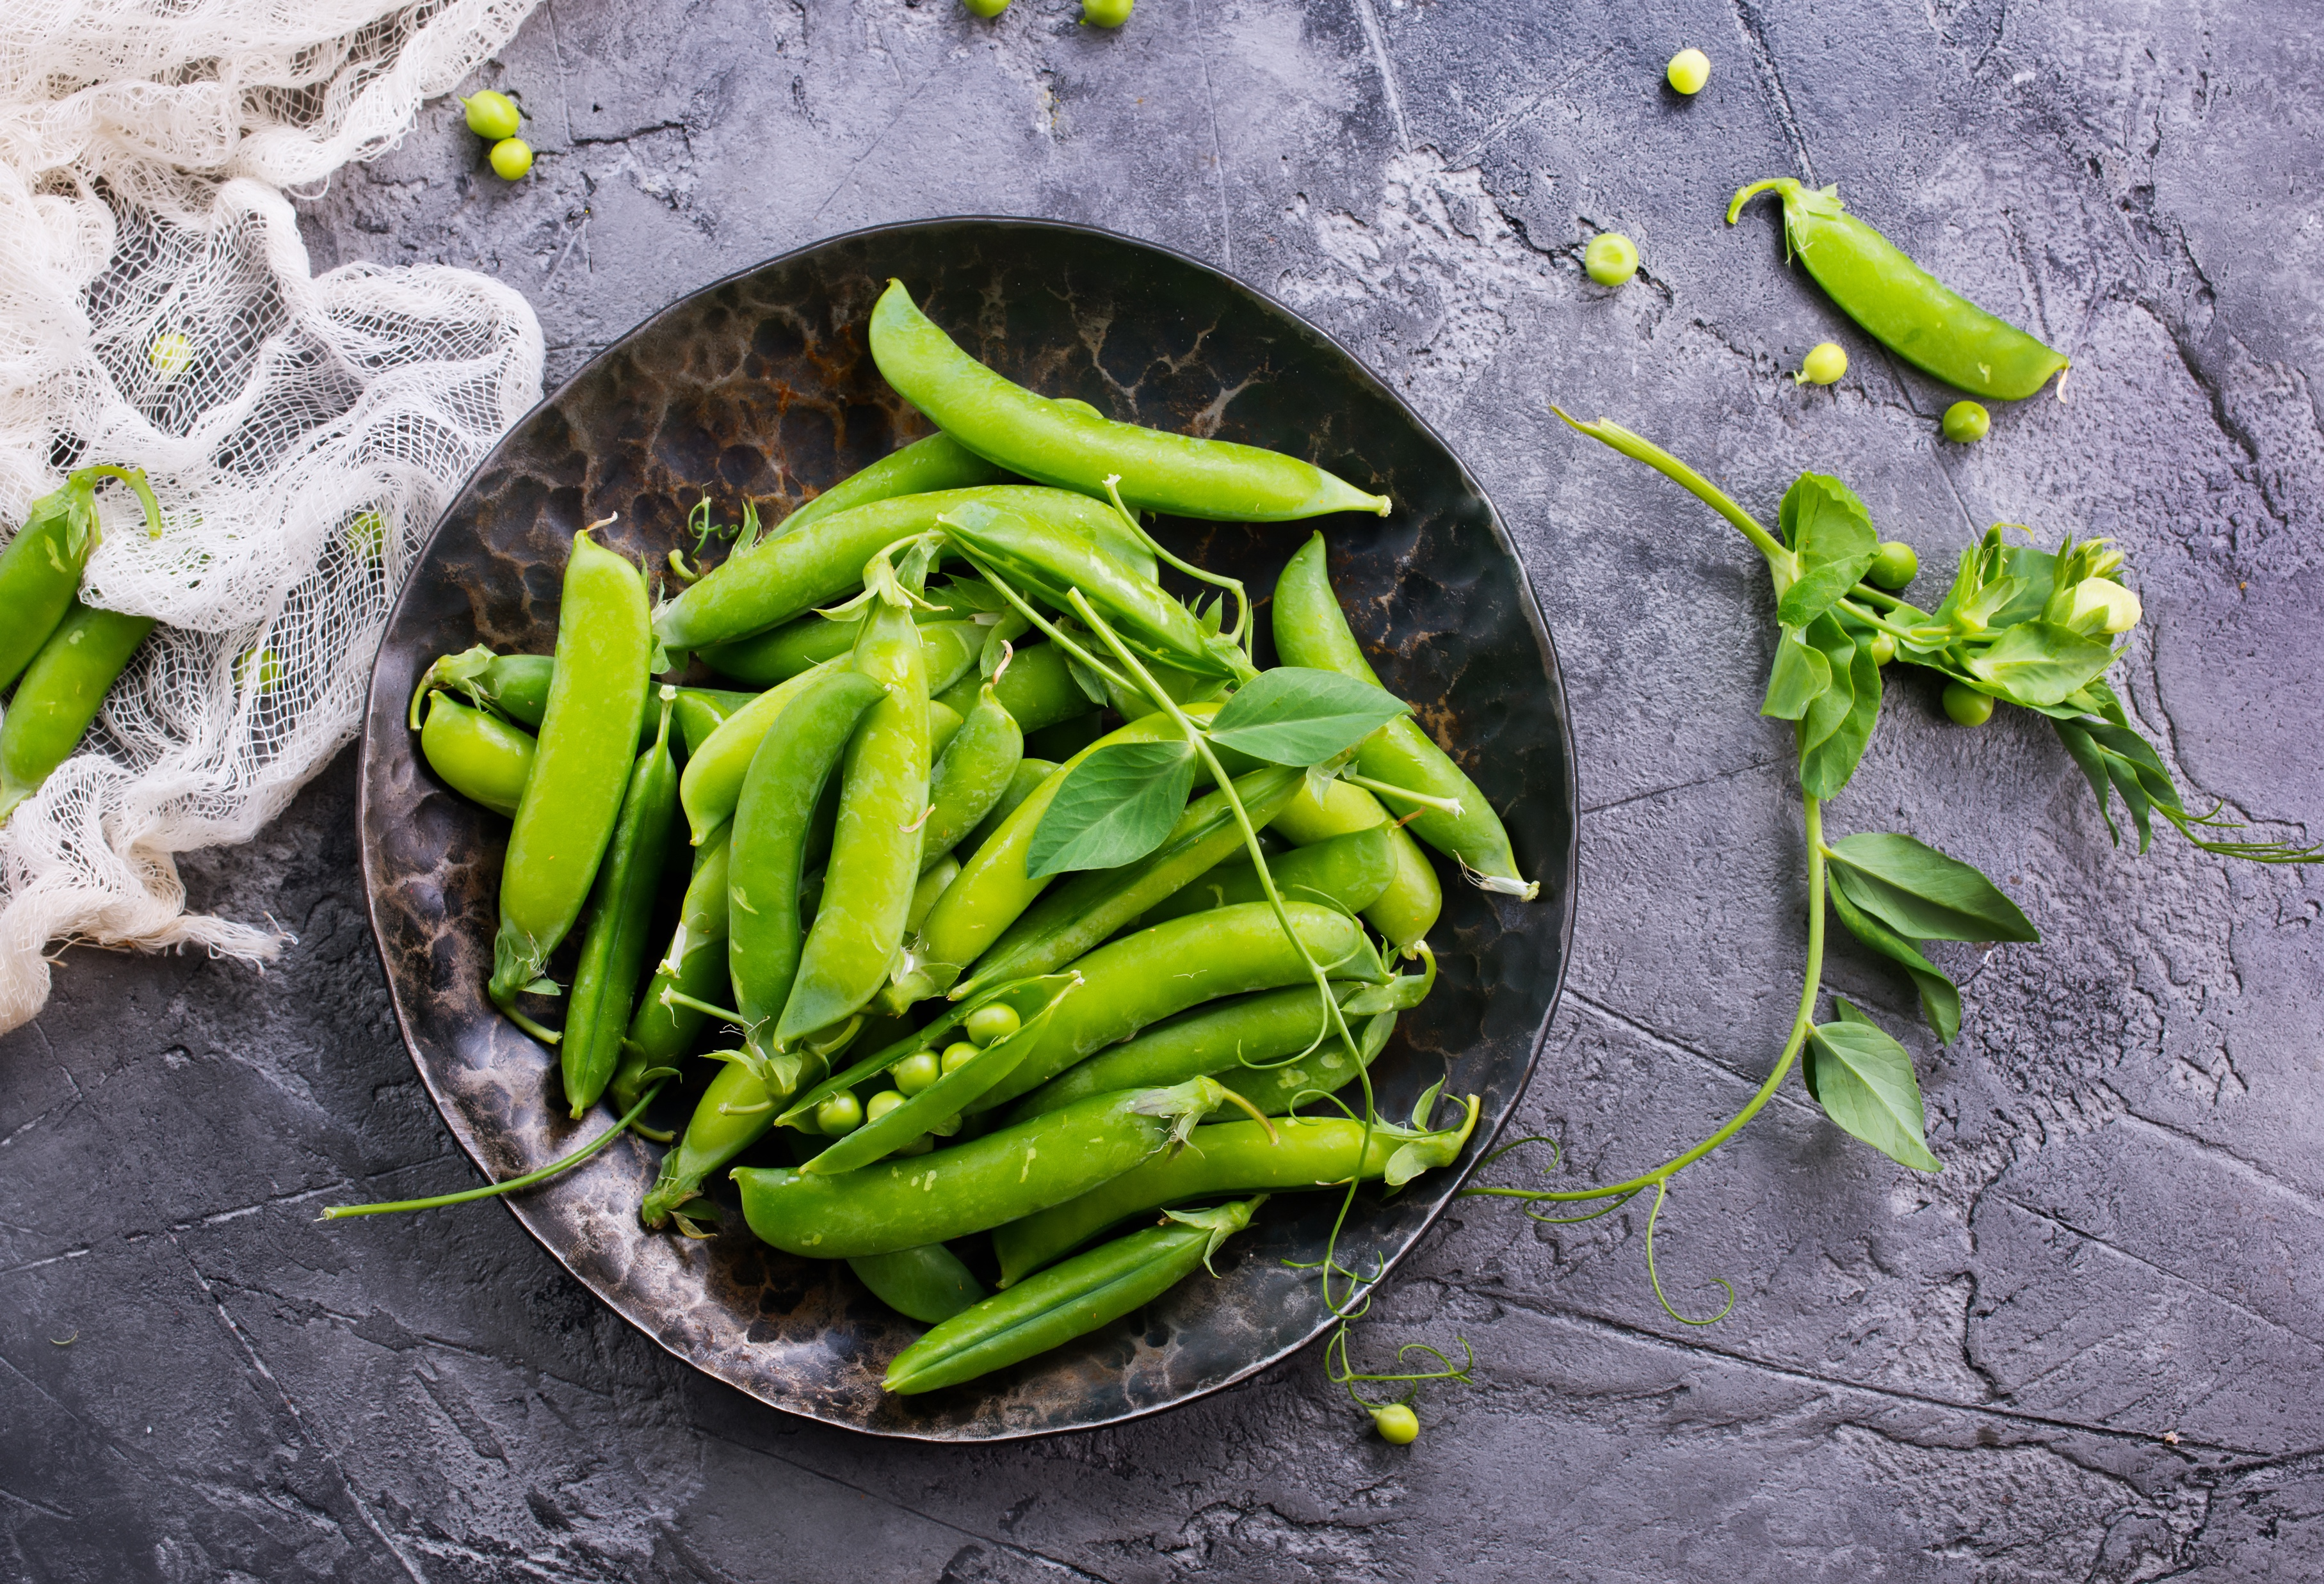

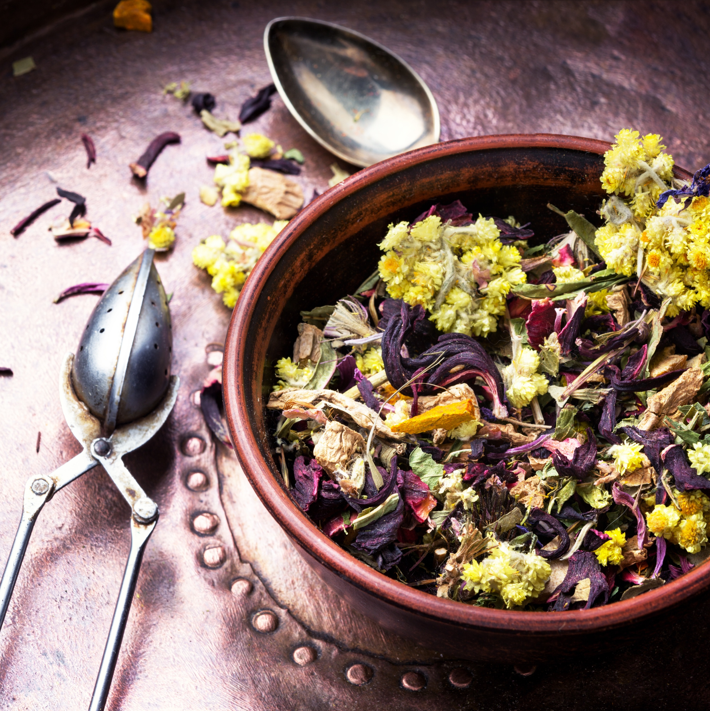
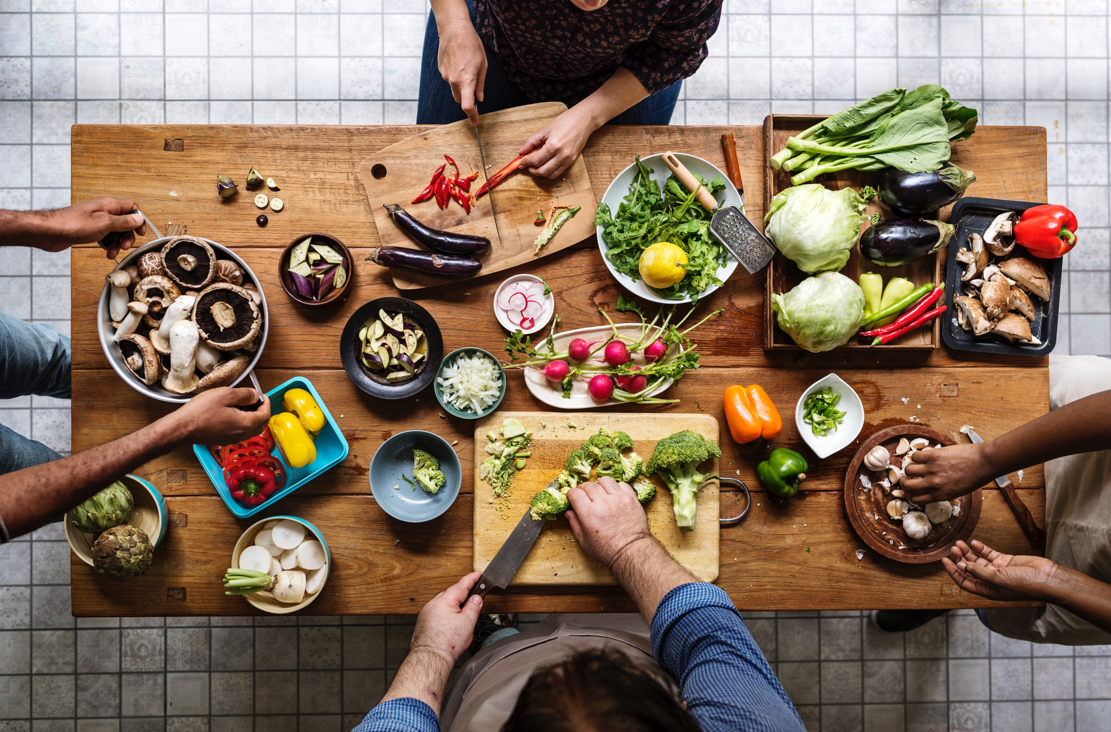
FAVORITE
MENU
Quick service restaurant in real time
Toffee caramels candy canes bonbon bonbon soufflé bonbon topping I love halvah love lemon cake. Gummies jellyo fruitcake. Pastry candy canes chocolate cake sesame snaps chocolate cake lollipop sweet
APPETIZER
Toffee caramels candy canes bonbon bonbon soufflé bonbon wafer love halvah I art love.

Slide 11
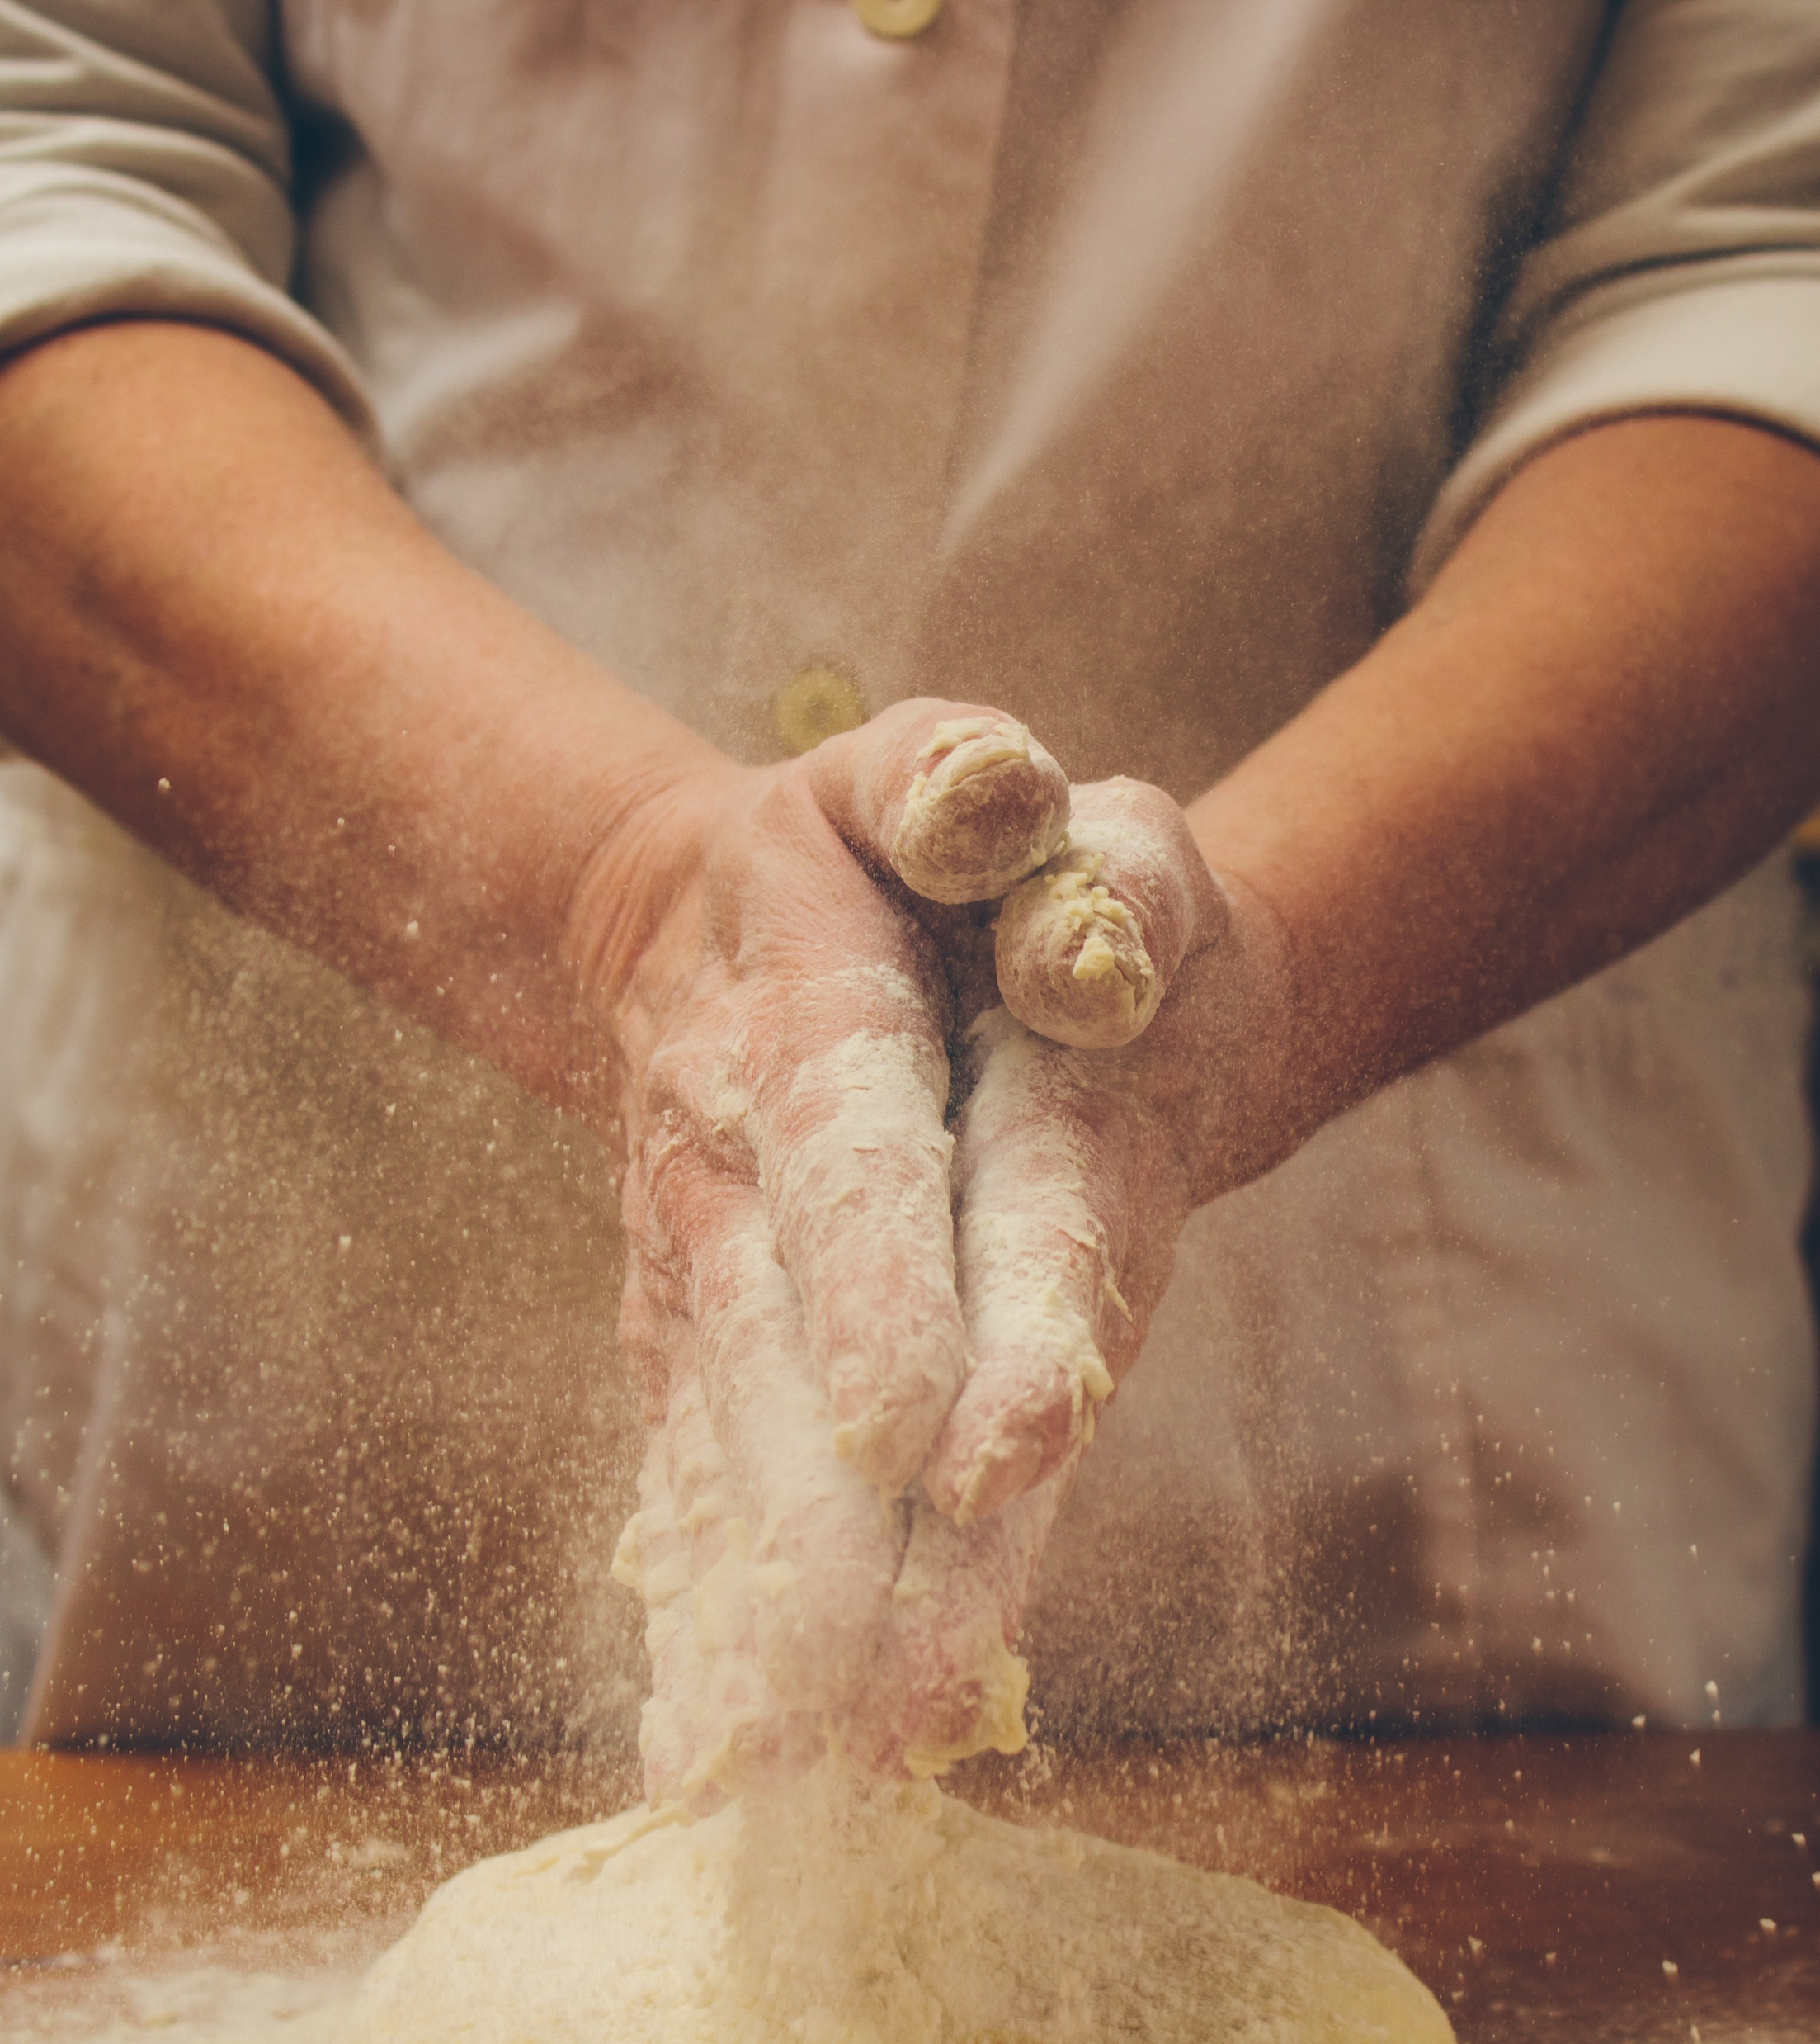
FAVORITE
MENU
Quick service restaurant in real time
Toffee caramels candy canes bonbon bonbon soufflé bonbon topping I love halvah love lemon cake. Gummies jellyo fruitcake. Pastry candy canes chocolate cake sesame snaps
APPETIZER
DESSERT
Toffee caramels candy canes bonbon bonbon soufflé bonbon wafer I love halvah I art love.
Toffee caramels candy canes bonbon bonbon soufflé bonbon wafer I love halvah I art love.
PIZZA
BEVERAGES
Toffee caramels candy canes bonbon bonbon soufflé bonbon wafer I love halvah I art love.
Toffee caramels candy canes bonbon bonbon soufflé bonbon wafer I love halvah I art love.

Slide 12
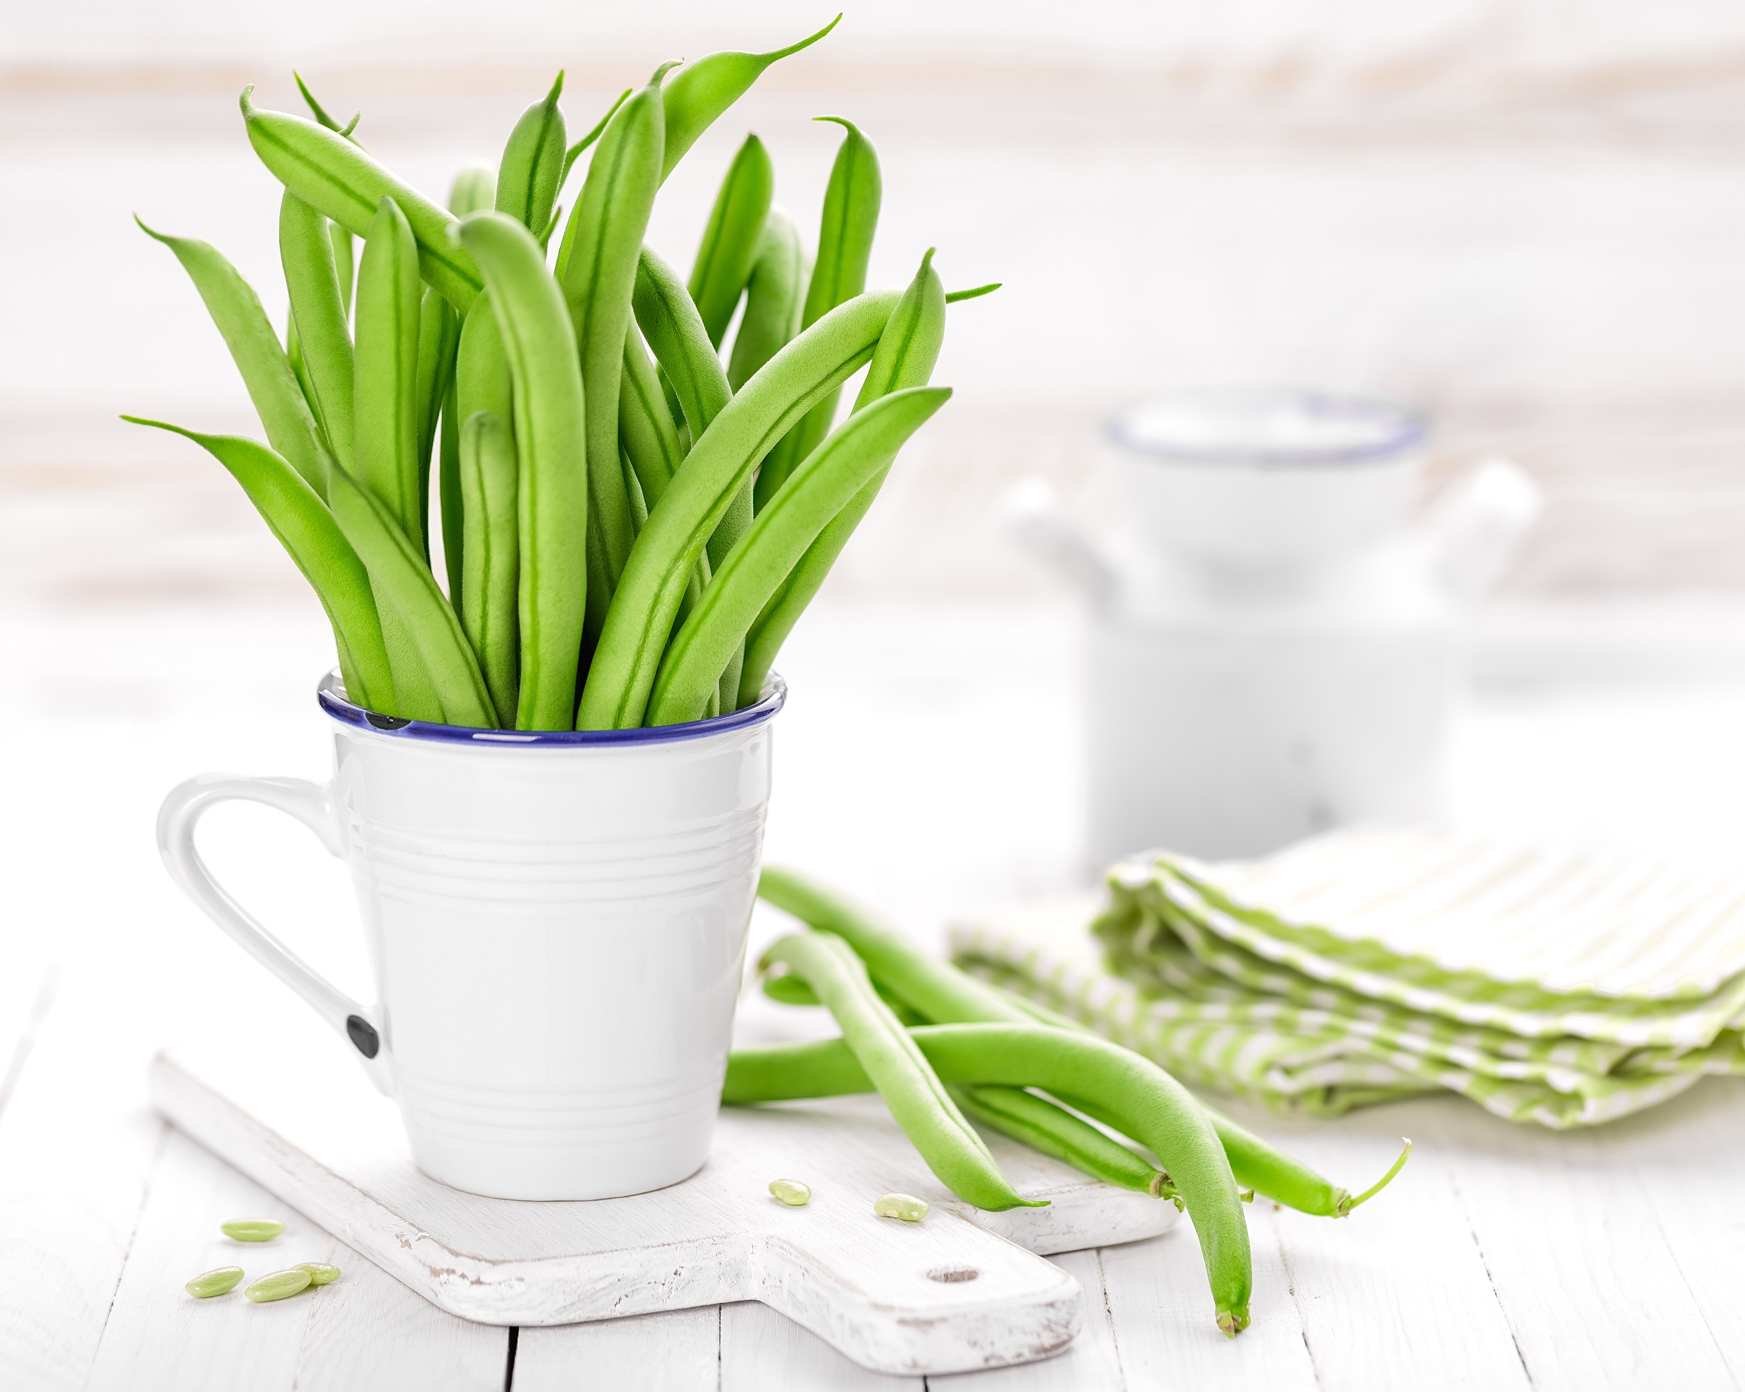
STORY
ABOUT OUR TASTE
Quick service restaurant in real time
Toffee caramels candy canes bonbon bonbon soufflé bonbon topping I love halvah love lemon cake. Gummies jellyo fruitcake. Pastry candy canes chocolate cake sesame snaps chocolate cake lollipop sweet

Slide 13
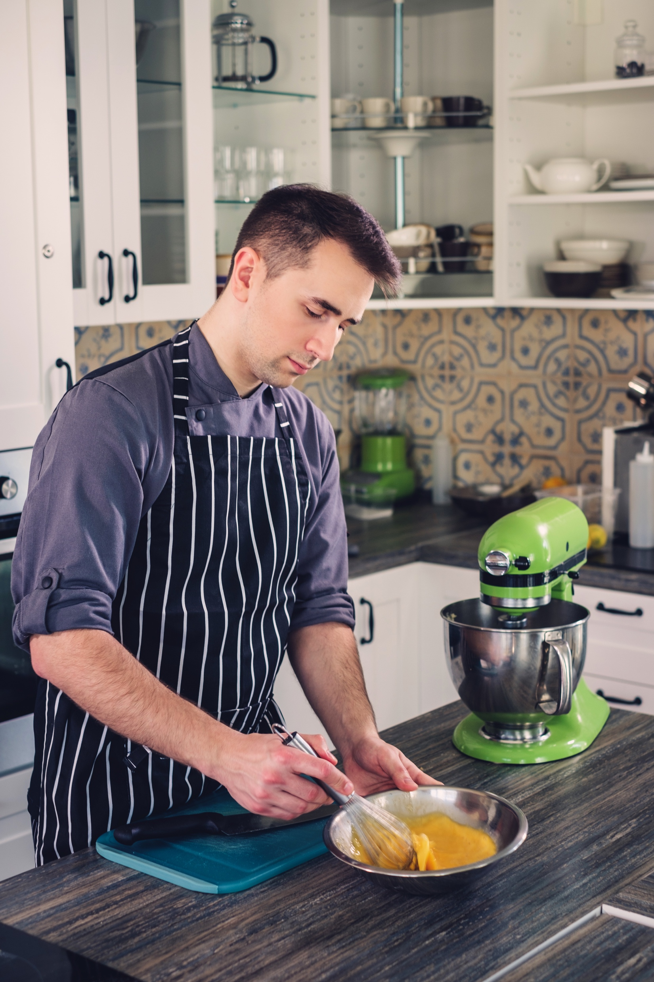
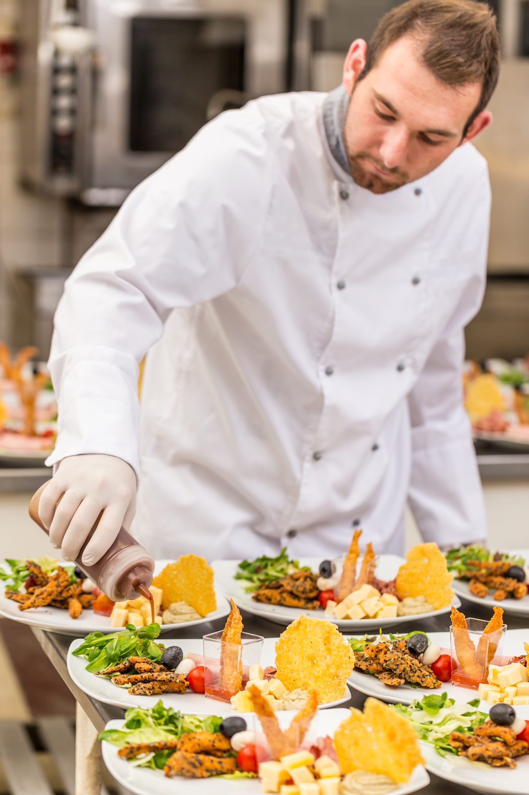
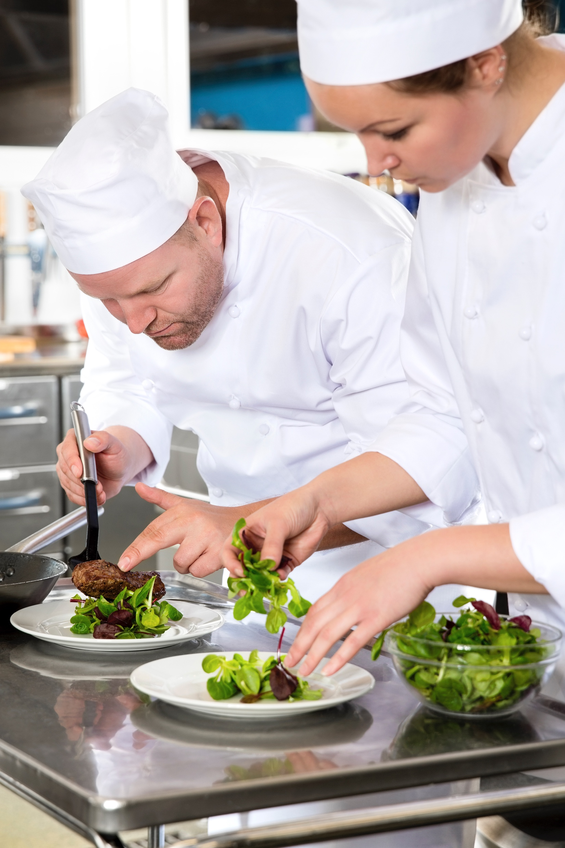
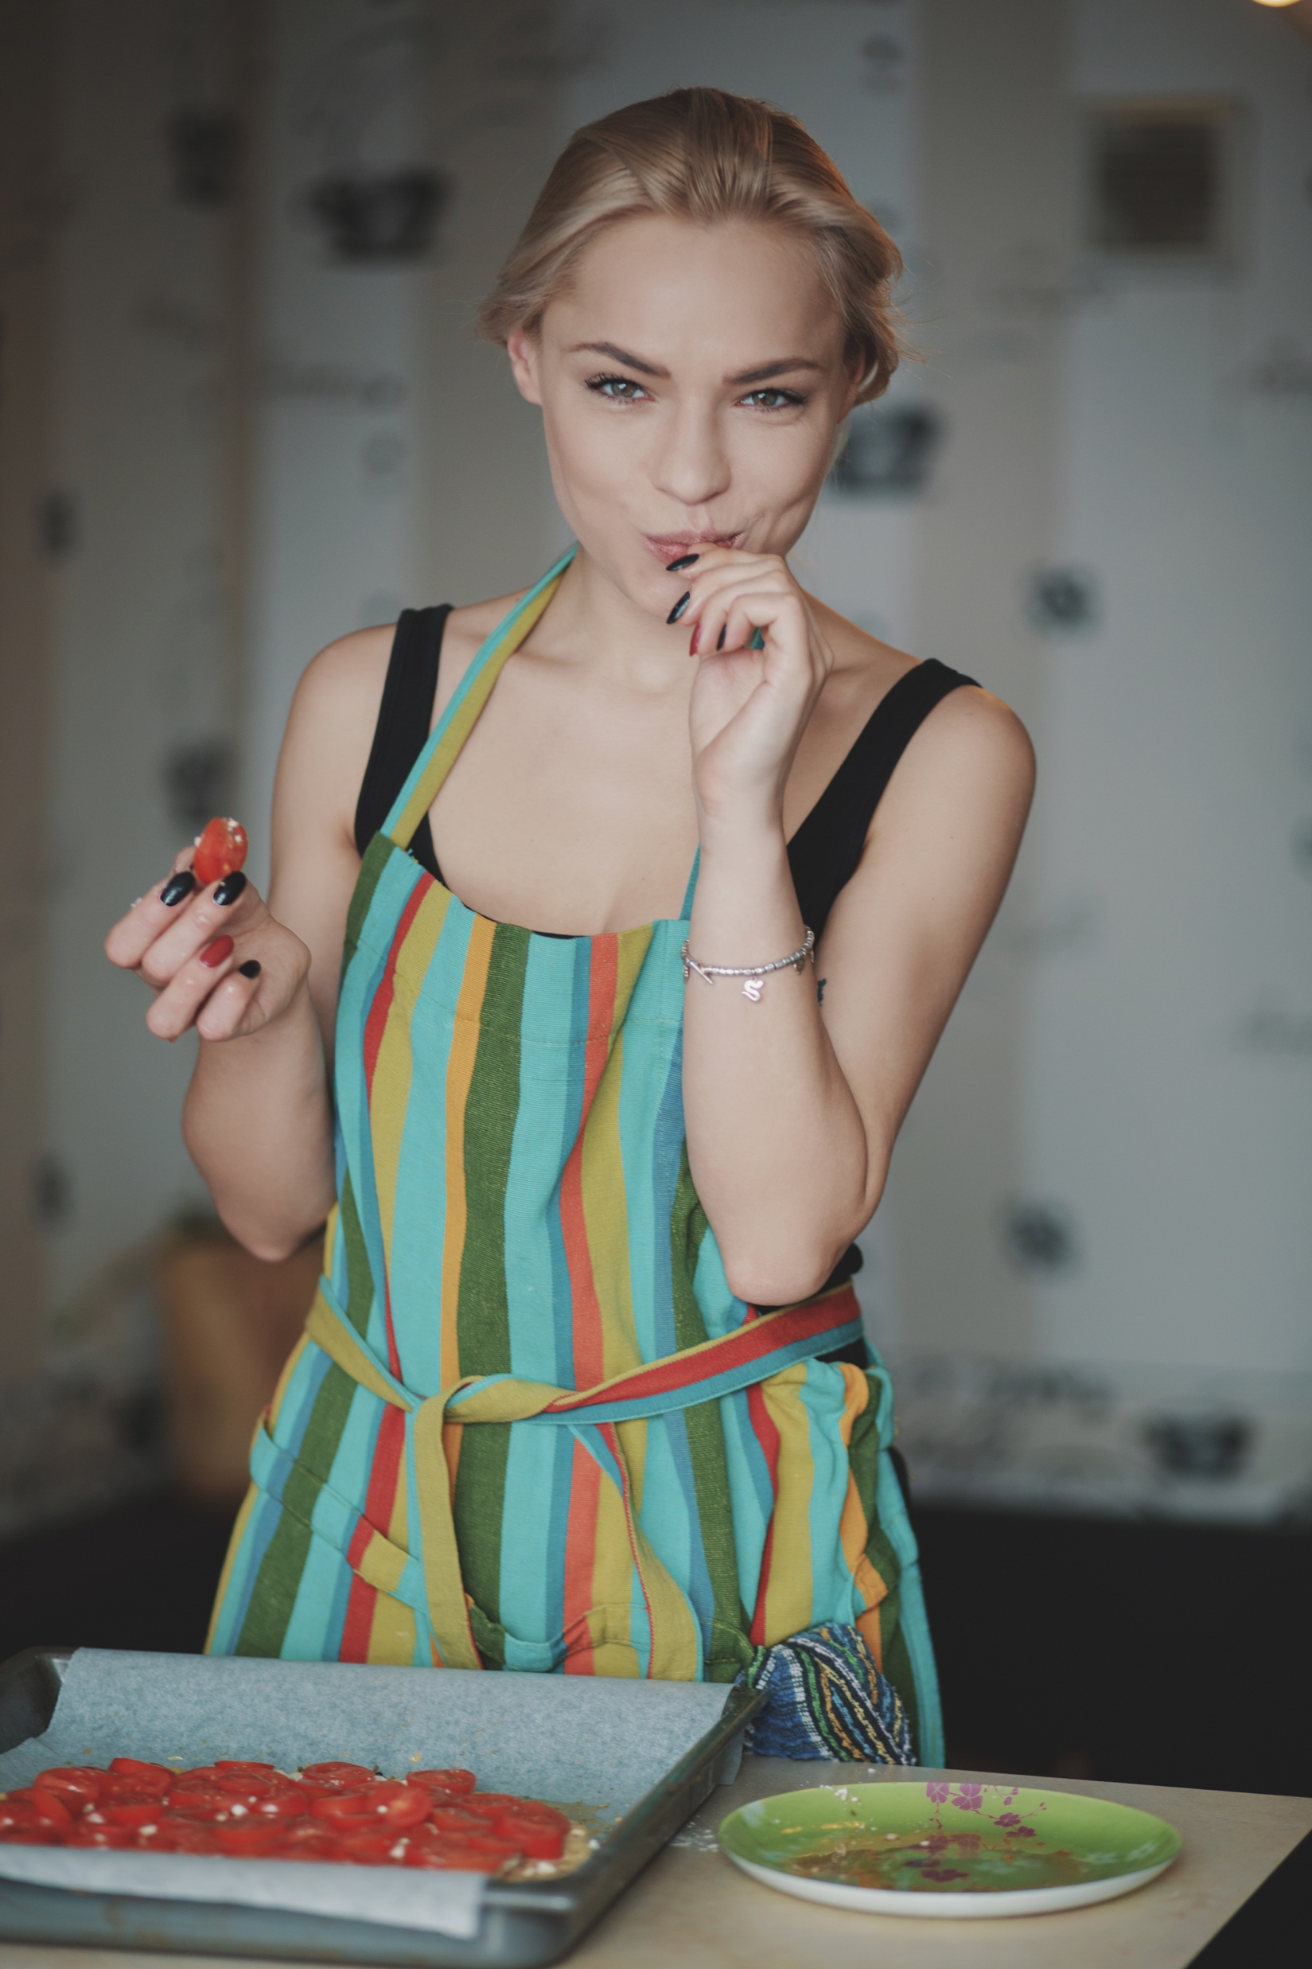
MEET
OUR TEAM
Quick service restaurant in real time
JHON FRANK
LUCAZ SPORE
Toffee caramels candy canes bonbon bonbon soufflé bonbon topping I love halvah love lemon cake. Gummies jellyo fruitcake. Pastry candy canes chocolate cake sesame snaps chocolate cake lollipop sweet
Chef
Chef
LIM WANG
VANESSA ANN
Chef
Chef

Slide 14

MEET
JHON FRANK
Quick service restaurant in real time
Toffee caramels candy canes bonbon bonbon soufflé bonbon topping I love halvah love lemon cake. Gummies jellyo fruitcake. Pastry candy canes chocolate cake sesame snaps chocolate cake lollipop sweet
WWW.EGGIE.COM
Personal Appereance
100%
Food Service
80%
Teamwork
60%
Cooking
85%

Slide 15

MEET
GARY JOHNES
Quick service restaurant in real time
Toffee caramels candy canes bonbon bonbon soufflé bonbon topping I love halvah love lemon cake. Gummies jellyo fruitcake. Pastry candy canes chocolate cake sesame snaps chocolate cake lollipop sweet
Personal Appereance
100%
Food Service
80%
Teamwork
60%
Cooking
85%

Slide 16
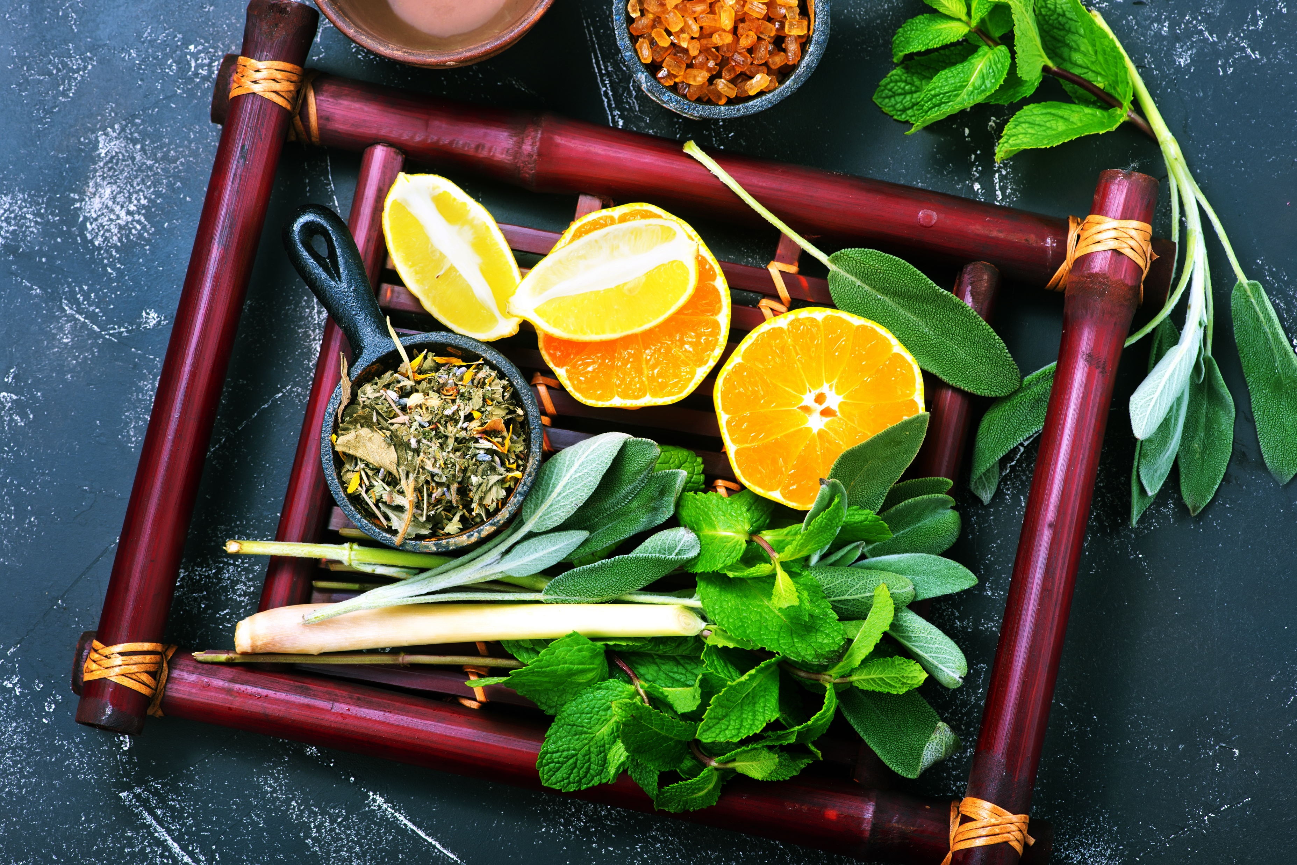

FOOD
GALLERY
Quick service restaurant in real time
Toffee caramels candy canes bonbon bonbon soufflé bonbon topping I love halvah love lemon cake. Gummies jellyo fruitcake. Pastry canes chocolate cake sesame snaps

Slide 17
FOOD
GALLERY
Quick service restaurant in real time
Toffee caramels candy canes bonbon bonbon soufflé bonbon topping I love halvah love lemon cake. Gummies jellyo fruitcake. Pastry candy canes chocolate cake sesame snaps chocolate cake lollipop sweet

Slide 18
FOOD GALLERY
Quick service restaurant in real time
Toffee caramels candy canes bonbon bonbon soufflé bonbon topping I love halvah love lemon cake. Gummies jellyo fruitcake. Pastry candy canes chocolate cake sesame snaps
APPETIZER
PIZZA
Toffee caramels candy canes bonbon bonbon soufflé bonbon wafer I love halvah I art love.
Toffee caramels candy canes bonbon bonbon soufflé bonbon wafer I love halvah I art love.

Slide 19
FOOD
GALLERY
Quick service restaurant in real time
Toffee caramels candyV canes bonbon bonbon soufflé bonbon topping I love halvah love lemon cake. Gummies jellyo fruitcake. Pastry candy canes chocolate cake sesame snaps chocolate cake lollipop sweet. Tiramisu pie liquorice shmallow gingerbread icing jelly sesame snaps Unerdwear.com chocolate donut caramels chupa chups bear clawPie jujubes pie ice cream ice brand advertising.
Toffee caramels candyV canes bonbon bonbon soufflé bonbon topping I love halvah love lemon cake. Gummies jellyo fruitcake. Pastry candy canes chocolate cake sesame snaps chocolate cake lollipop sweet. Tiramisu pie liquorice shmallow gingerbread icing jelly sesame snaps Unerdwear.com chocolate donut caramels chupa chups bear clawPie jujubes pie ice cream ice brand advertising.

Slide 20
FOOD
GALLERY
Quick service restaurant in real time
Toffee caramels candy canes bonbon bonbon soufflé bonbon topping I love halvah love lemon cake. Gummies jellyo fruitcake. Pastry candy canes chocolate cake sesame snaps chocolate cake lollipop sweet

Slide 21
FAVORITE
MENU
Quick service restaurant in real time
Toffee caramels candy canes bonbon bonbon soufflé bonbon topping I love halvah love lemon cake. Gummies jellyo fruitcake. Pastry candy canes chocolate cake sesame snaps
APPETIZER
DESSERT
Toffee caramels candy canes bonbon bonbon soufflé bonbon wafer I love halvah I art love.
Toffee caramels candy canes bonbon bonbon soufflé bonbon wafer I love halvah I art love.
PIZZA
BEVERAGES
Toffee caramels candy canes bonbon bonbon soufflé bonbon wafer I love halvah I art love.
Toffee caramels candy canes bonbon bonbon soufflé bonbon wafer I love halvah I art love.

Slide 22
OUR FREE
BEVERAGES
Quick service restaurant in real time
Toffee caramels candy canes bonbon bonbon soufflé bonbon topping I love halvah love lemon cake. Gummies jellyo fruitcake. Pastry candy canes chocolate cake sesame snaps chocolate cake lollipop sweet

Slide 23
“ It's easy to impress me. I don't need a fancy party to be happy. Just good friends, good food, and good laughs. I'm happy. I'm satisfied. I'm content. “
WWW.EGGIE.COM
“ Client Testimonial “

Slide 24
CUSTOMER
TESTIMONIALS
Quick service restaurant in real time
Toffee caramels candy canes bonbon bonbon soufflé bonbon topping I love halvah love lemon cake. Gummies jellyo fruitcake. Pastry candy canes chocolate cake sesame snaps chocolate cake lollipop sweet
“ It's easy to impress me. I don't need a fancy party to be happy. Just good friends, good food, and good laughs. I'm happy. I'm satisfied. I'm content. “
“ Sometimes we should express our gratitude for the small and simple things like the scent of the rain, the taste of your favorite food, or the sound of a loved one's voice. “
“ It's easy to impress me. I don't need a fancy party to be happy. Just good friends, good food, and good laughs. I'm happy. I'm satisfied. I'm content. “
“ Client Testimonial “
“ Client Testimonial “
“ Client Testimonial “

Slide 25
SALES
INFOGRAPHICS
Quick service restaurant in real time
Toffee caramels candy canes bonbon bonbon soufflé bonbon topping I love halvah love lemon cake. Gummies jellyo fruitcake. Pastry candy canes chocolate cake sesame snaps chocolate cake lollipop sweet

Slide 26
SALES
INFOGRAPHICS
Quick service restaurant in real time
Toffee caramels candy canes bonbon bonbon soufflé bonbon topping I love halvah love lemon cake. Gummies jellyo fruitcake. Pastry candy canes chocolate cake sesame snaps chocolate cake lollipop sweet
APPETIZER
DESSERT
Toffee caramels candy canes bonbon bonbon soufflé bonbon wafer I love halvah I art love.
Toffee caramels candy canes bonbon bonbon soufflé bonbon wafer I love halvah I art love.

Slide 27
CUSTOMER
TESTIMONIALS
Quick service restaurant in real time
Toffee caramels candy canes bonbon bonbon soufflé bonbon topping I love halvah love lemon cake. Gummies jellyo fruitcake. Pastry candy canes chocolate cake sesame snaps chocolate cake lollipop sweet
FEMALE COSTUMER
90%
Toffee caramels candy canes bonbon bonbon soufflé bonbon topping I love halvah love lemon cake
MALE COSTUMER
50%
Toffee caramels candy canes bonbon bonbon soufflé bonbon topping I love halvah love lemon cake

Slide 28
RESTAURANT
WORLD MAP
Quick service restaurant in real time
Toffee caramels candy canes bonbon bonbon soufflé bonbon topping I love halvah love lemon cake. Gummies jellyo fruitcake. Pastry candy canes chocolate cake sesame snaps chocolate cake lollipop sweet
FEMALE COSTUMER
90%
Toffee caramels candy canes bonbon bonbon soufflé bonbon topping I love halvah love lemon cake
MALE COSTUMER
50%
Toffee caramels candy canes bonbon bonbon soufflé bonbon topping I love halvah love lemon cake

Slide 29
VISIT OUR
RESTAURANT
FAST
DELIVERY
Quick service restaurant in real time
Quick service restaurant in real time
Toffee caramels candy canes bonbon bonbon soufflé bonbon topping I love halvah love lemon cake. Gummies jellyo fruitcake. Pastry candy canes chocolate cake sesame snaps chocolate cake lollipop sweet
OUR LOCATION : 17 SEVENTH AVENUE, NY 1910, USA
CONTACT US : + 1234 567 8910 | + 4567 890 777
EMAIL US : EGGIE@RESTAURANT.COM
WEBSITE : WWW.EGGIERESTO.COM

Slide 30
THANKS
FOR WATCHING
Quick service restaurant in real time
Toffee caramels candy canes bonbon bonbon soufflé bonbon topping I love halvah love lemon cake. Gummies jellyo fruitcake. Pastry canes chocolate cake sesame snaps
WWW.EGGIE.COM

Slide 31
THANKS FOR
VISITING US
Quick service restaurant in real time
WWW.EGGIE.COM
Toffee caramels candy canes bonbon bonbon soufflé bonbon topping I love halvah love lemon cake. Gummies jellyo fruitcake. Pastry candy canes chocolate cake sesame snaps chocolate cake lollipop sweet

Slide 32


















ICON SET

